Slide 1

Protecting Wildlife on Florida’s Roads
A Data-Driven Look at Wildlife-Vehicle Collisions in State Parks
By: Sarah Theriot

Slide 2
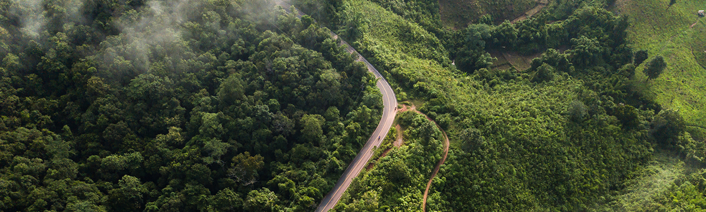
Why Wildlife-Vehicle Collisions Matter
Thousands of animals are killed on Florida roads every year
Collisions pose serious risks to both wildlife and drivers
Roads fragment habitats, threatening long-term species survival
State parks offer key opportunities for safer wildlife crossings

Slide 3
Research Question & Goals
Where and when do wildlife-vehicle collisions happen most often in Florida state parks?
Project Goals:
Identify collision hotspots
Explore seasonal and road-type patterns
Understand potential links to human activity (e.g., park attendance)
Support data-informed solutions like wildlife crossings

Slide 4

The Dataset: Wildlife Collisions in Florida Parks (2005-2015)
9,000+ collision records
Data from 42 Florida state parks
Covers 2005 to 2015
Includes species, number of animals, road type, park name, and attendance
Source: Gunther et al. (2020), via Dryad

Slide 5
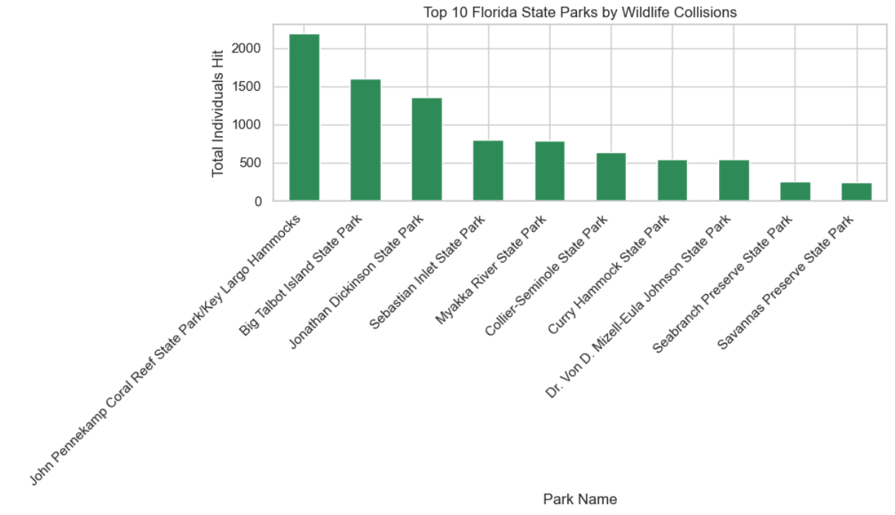
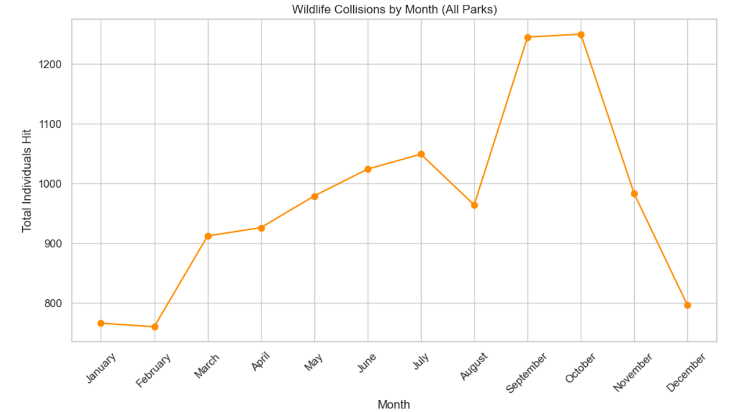
How I Analyzed the Data
Used summary statistics to find top parks and species involved
Bar charts and scatter plots for visual trends
Explored patterns by month, road type, and park attendance
Focused on clear, visual storytelling over complex modeling (for now)

Slide 6
Where are the Collision Hotspots?
Collisions aren’t spread evenly across parks
Top parks with high collision numbers:
John Pennekamp Coral Reef
Big Talbot Island
Jonathan Dickinson
These may be prime candidates for wildlife crossings

Slide 7
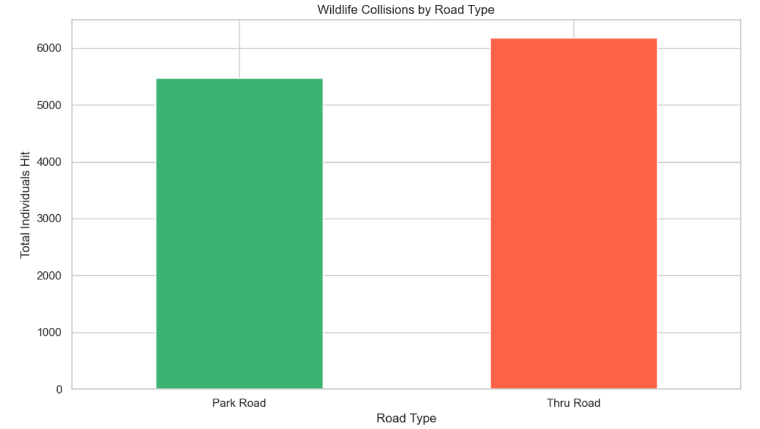
When and Where Collisions Happen Most
Seasonal trends:
Road Types matter:
Collisions peak in late summer and fall
Spring is also high; winter months (Jan–Feb) are lower
Through-roads (faster traffic) have more collisions
Smaller internal roads are generally safer

Slide 8
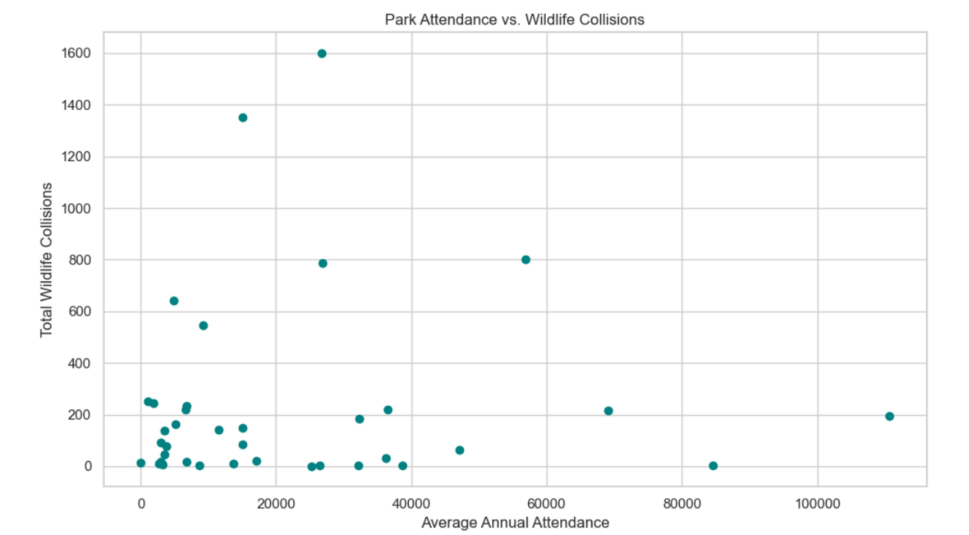
Does Park Attendance Affect Collisions
Compared collisions with park attendance numbers
Found no strong correlation between attendance and collisions
Suggests factors like road design and wildlife presence might matter more than visitor count

Slide 9
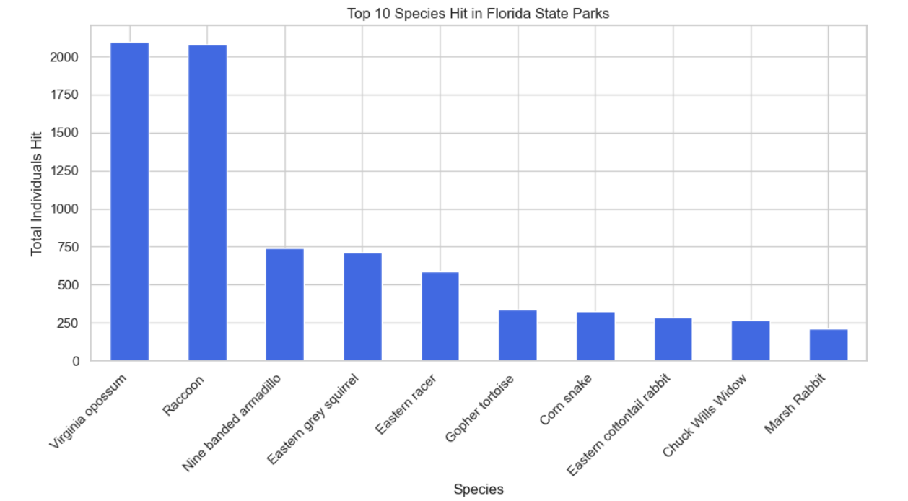
Which Wildlife Are Most Affected?
Top species involved:
Opossums
Raccoons
Armadillos
Squirrels
Snakes
Potentially reflect species behaviors and visibility to drivers

Slide 10
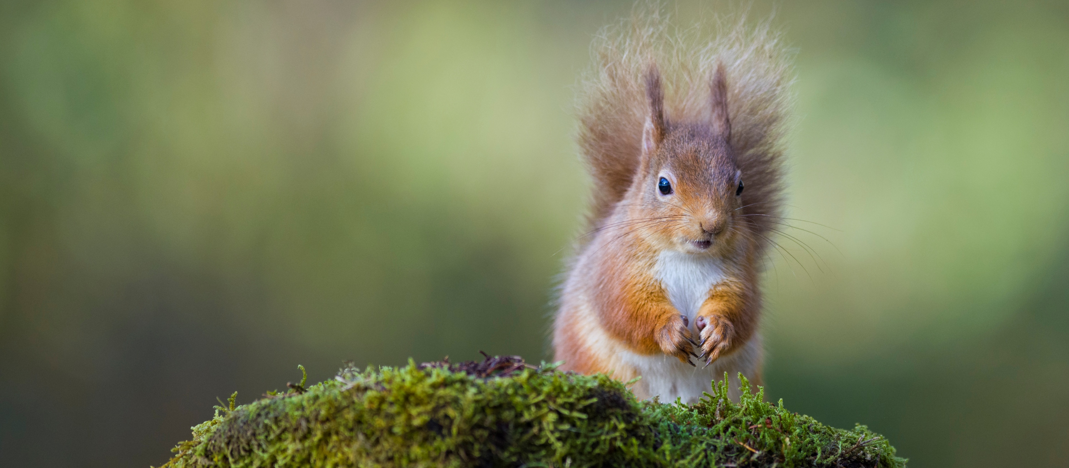
Understanding the Limits of the Data
Collisions reported may underrepresent smaller animals
Reporting quality varies between parks
Data only goes up to 2015 — may not reflect current conditions
Results are a starting point, not definitive answers

Slide 11
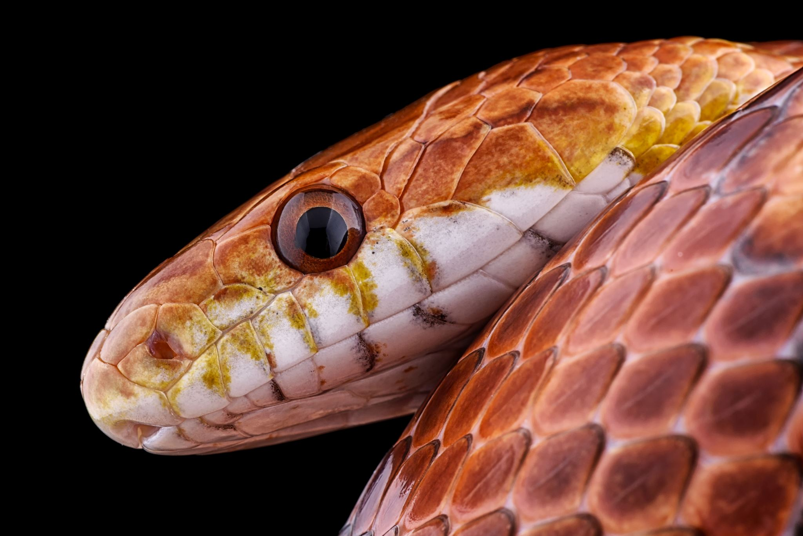
Using the Data to Protect Wildlife
Prioritize high-collision parks for wildlife crossings and safety measures
Update and expand collision data collection regularly
Implement consistent reporting systems across parks
Consider targeted interventions like speed limits and signage

Slide 12

Putting Solutions Into Action
Develop a shared, standardized reporting system for all parks
Create an app for real-time wildlife sightings and collision reports
Engage community and stakeholders to build support and funding
Use data storytelling to raise awareness and drive change

Slide 13
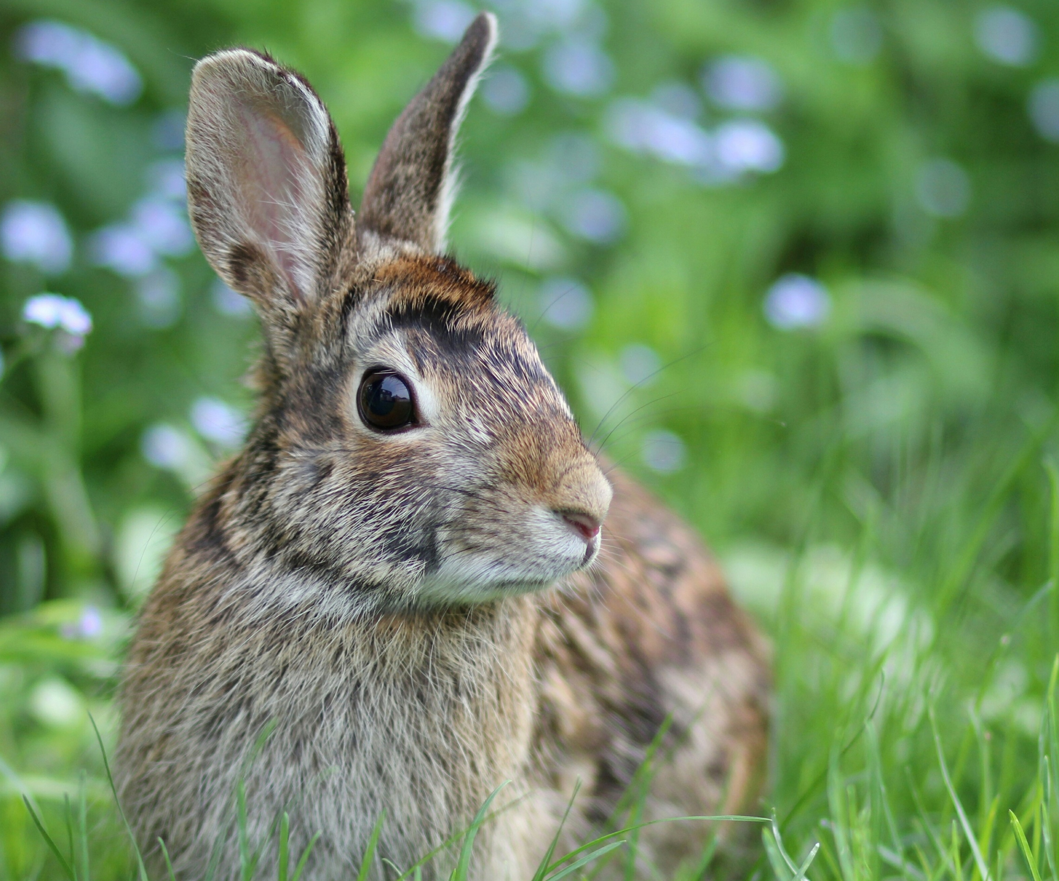
Ethics in Wildlife Collision Data
Animals represent real lives lost, not just data points
Avoid blaming parks for high collision numbers (reporting quality and wildlife abundance matter)
Use data responsibly to inform, not stigmatize
Aim for respectful, solution-focused communication

Slide 14
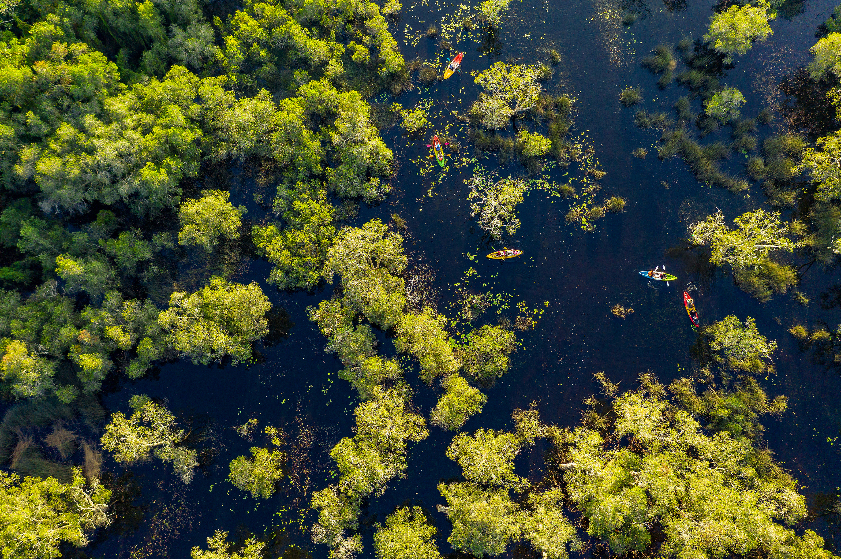
Summary & Next Steps
Wildlife-vehicle collisions vary by park, season, and road type
Data-driven insights can guide targeted interventions
Ongoing data collection and community engagement are crucial
Hope to inspire safer roads for both wildlife and people

Slide 15
Questions?
Pre-Submitted Questions:
How did you handle the fact that your dataset ends in 2015?
Were there any parks that surprised you by how many collisions they had?
Could the attendance number be skewing the collision data?
Why do you think certain species show up more often?
Were there any patterns by month that stood out?
What would you say to someone to help them decide if it is worth investing in building wildlife crossings?
What was your biggest challenge in analyzing the data?
How do you think this kind of analysis can help the real world?
How did you decide what visuals to use in your project?
What is one thing you wish your dataset included, but did not?

Slide 16
Answers Pt. 1
Q1: How did you handle the fact that your dataset ends in 2015?
Since the data only goes up to 2015, I treated this project as a historical snapshot rather than a current analysis. I also emphasized the need for updated data to see if patterns have shifted and to validate whether recommendations still hold true today.
Q2: Were there any parks that surprised you by how many collisions they had?
Yes, some parks like Big Talbot Island had higher collision numbers than I expected given their size. It highlights that collision risk isn’t just about park size or visitor numbers but involves factors like road type and wildlife presence.
Q3: Could the attendance number be skewing the collision data?
I looked into that by comparing collisions with attendance and found no strong correlation. This suggests that attendance alone doesn’t drive collisions; road design and wildlife activity likely play bigger roles.

Slide 17
Answers Pt. 2
Q4: Why do you think certain species show up more often?
Species like opossums and raccoons show up more often likely because they’re active at night, forage near roads, and are big enough to be noticed and reported. Smaller or more elusive animals may be underreported.
Q5: Were there any patterns by month that stood out?
Yes, collisions peaked in late summer and fall, with another increase in spring. These seasonal trends might be related to breeding, migration, or changes in animal movement patterns during those times.
Q6: What would you say to someone to help them decide if it is worth investing in building wildlife crossings?
I’d say the data shows clear hotspots where wildlife is consistently at risk, and targeted interventions like crossings can save animal lives and reduce driver injuries. It’s not just a conservation issue—it’s also about public safety.

Slide 18
Answers Pt. 3
Q7: What was your biggest challenge in analyzing the data?
One big challenge was dealing with the gaps and inconsistencies in reporting. Not all parks may have collected data the same way, and smaller collisions might be underreported, which makes interpretation more complex.
Q8: How do you think this kind of analysis can help the real world?
It gives park managers and policymakers a clearer picture of where wildlife is most at risk. That information can guide practical decisions—like where to lower speed limits, install signs, or consider building crossings.
Q9: How did you decide what visuals to use in your project?
I focused on visuals that told a clear story—bar charts to compare parks and species, scatter plots to explore attendance impact, and monthly breakdowns to show seasonality. The goal was to keep it easy to understand and actionable.
Q10: What is one thing you wish your dataset included, but did not?
I wish it had GPS coordinates for each collision. That would allow for more detailed spatial analysis and mapping, which could make the case for very specific intervention points along roads.

Slide 19
References
Gunther, M. S., et al. (2020). Wildlife-vehicle collisions at 42 Florida state parks (2005–2015). Dryad. https://doi.org/10.5061/dryad.qrfj6q5ds
Additional visuals, analysis, and interpretations created by Sarah Theriot using Python

